Slide 1
Mouse Dynamics for Hand Prediction by
Daniel Anyogo and
Suleiman Jibril-Ahmed

Slide 2
Research Question(s)
Can mouse movement patterns be used to predict which hand a user is using?
Do left and right hands produce different mouse behaviors?
Can these differences be detected using machine learning?

Slide 3
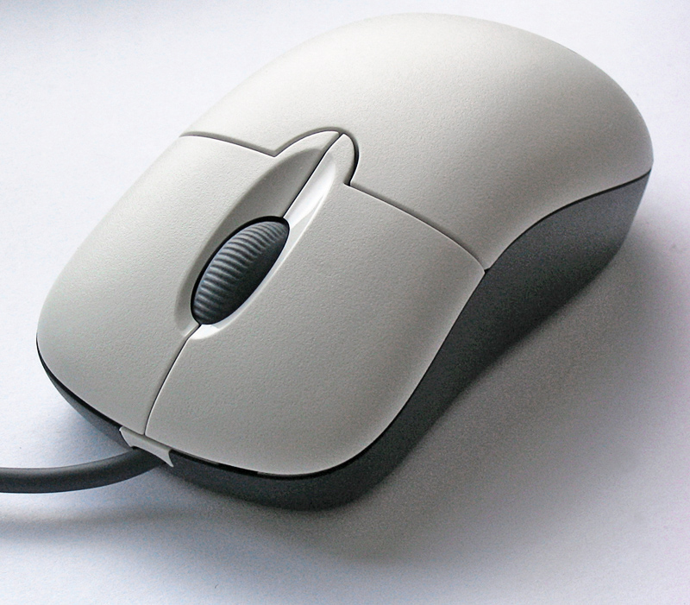
Behavioral Biometrics
We used mouse dynamics in this project:
  speed
  movement path
  curvature

Slide 4
Hypothesis
“Left and right hands produce different movement patterns and a machine learning model can classify hand usage based on these patterns”
Notes:
These differences include:
trajectory curvature
movement efficiency
direction behavior

Slide 5
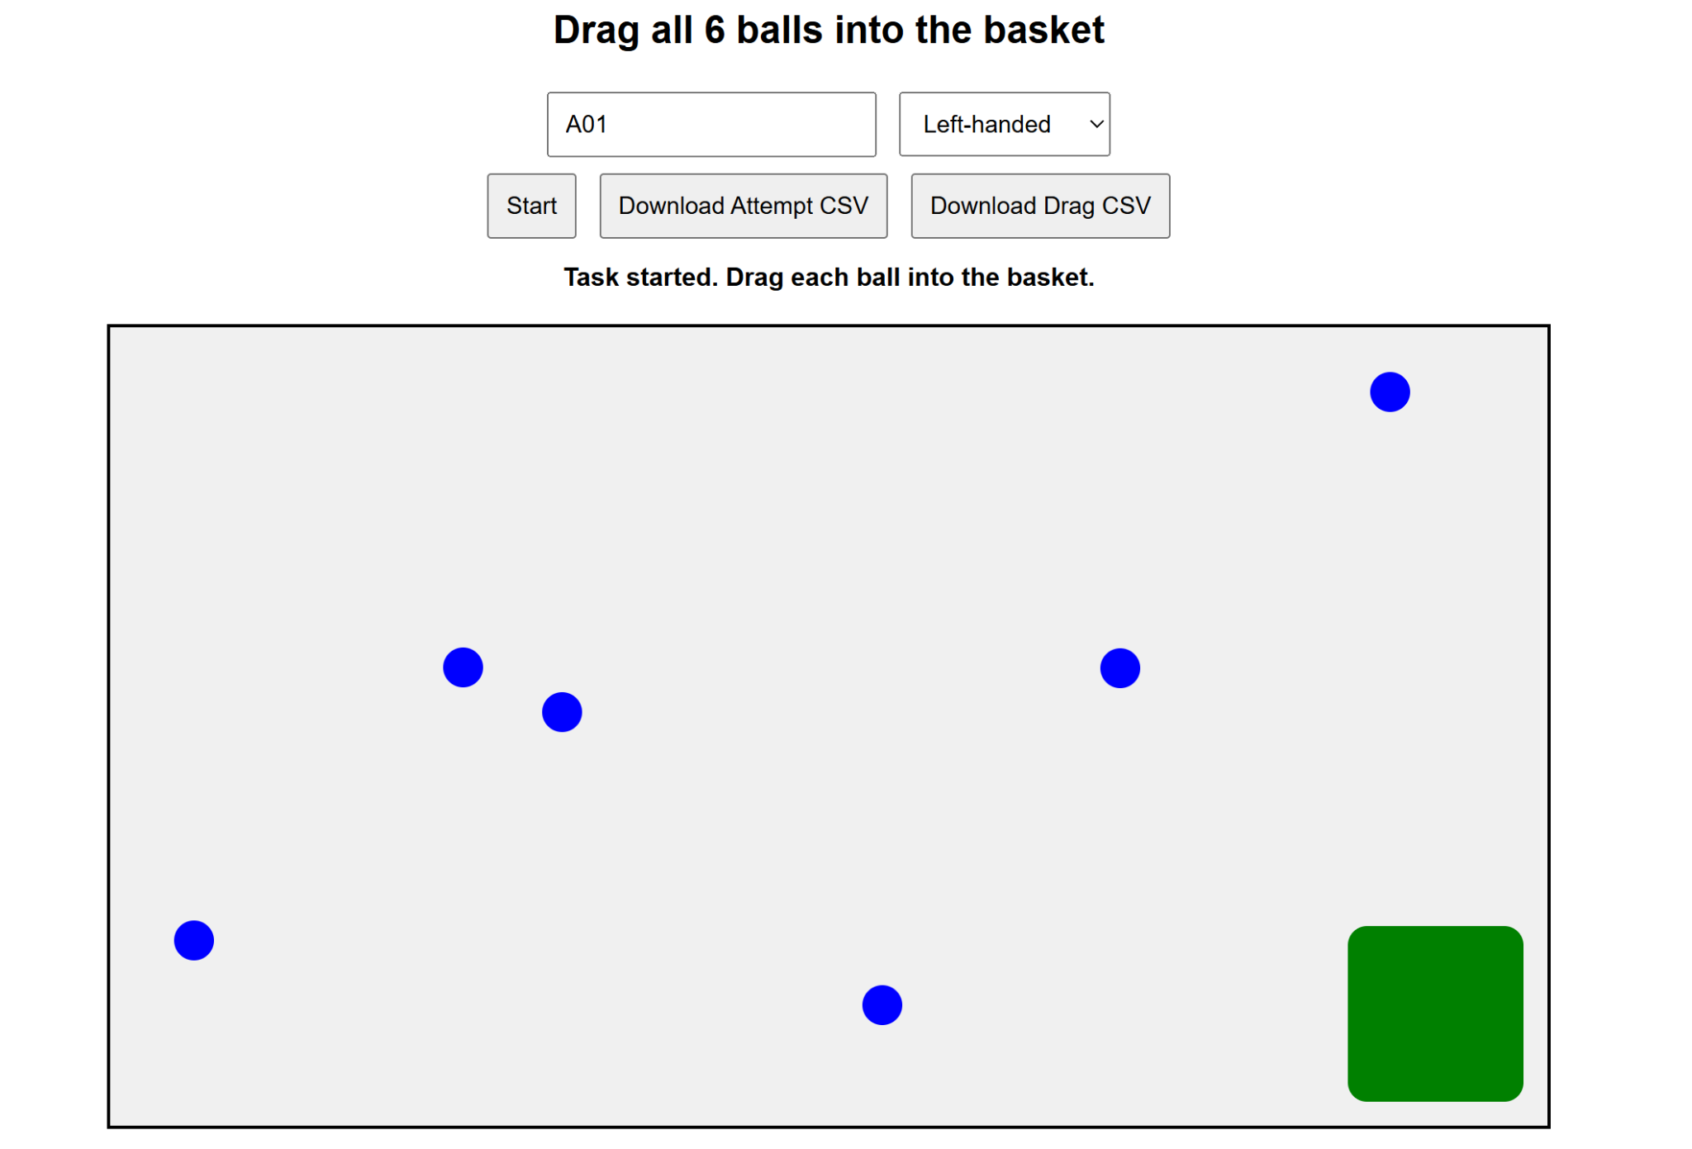
How we collected our data

Slide 6
Dataset
Users dragged balls into a basket
We would get 2 datasets:
Attempt-level (1 row per session)
Drag-level (1 row per drag) (Dropped)

Slide 7
Features collected
We collected 26 features and grouped them into these categories:
Task Performance
Distance & Efficiency
Speed & Acceleration
Smoothness
Movement Shape
Control & Corrections
Drag Behavior

Slide 8
Bias in the Data
Most users were right-handed
So when they would use their left hand:
  slower
  less accurate
So our Model learned that slow = left hand
We fixed this by:
Removing most time-based features
focusing on movement shape instead

Slide 9
Data Collection Error
We collected data but forgot to turn off this windows setting

Slide 10
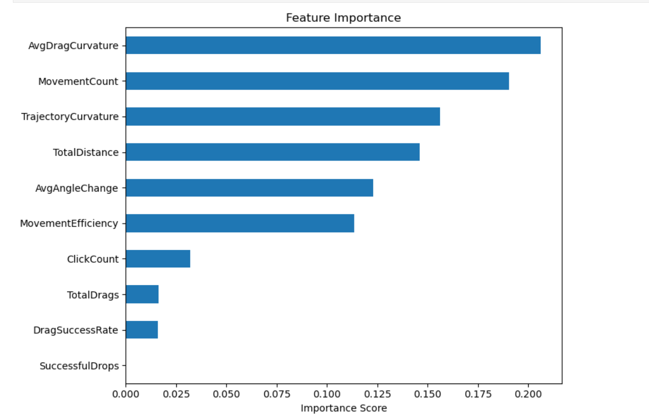
Key Insights
Mouse behavior can indicate hand usage
Speed is not reliable (biased)
Shape-based features are more reliable

Slide 11
Selected Features
AvgDragCurvature
MovementCount
TrajectoryCurvature
TotalDistance
AvgAngleChange
MovementEfficiency
ClickCount
TotalDrags
DragSuccessRate
SuccessfulDrops

Slide 12
Machine Learning Model
Models we used:
Random Forest
SVM
XGBoost
Key steps:
data cleaning
feature selection
Train

Slide 13
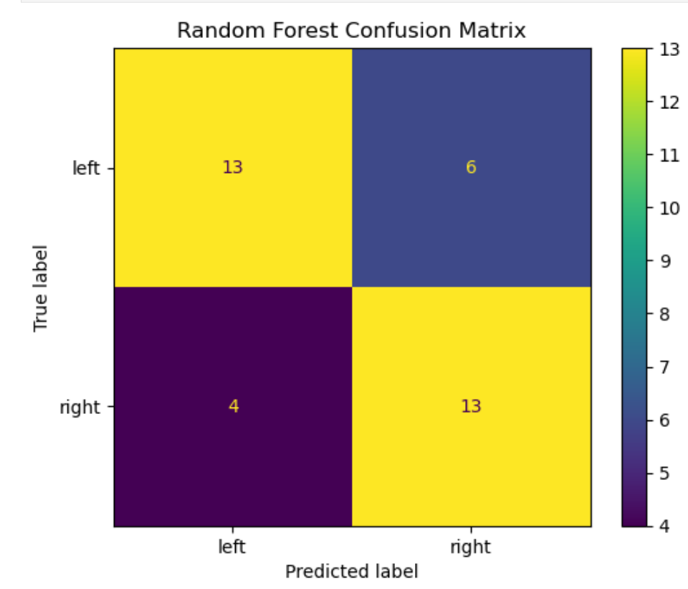
Predictions

Slide 14
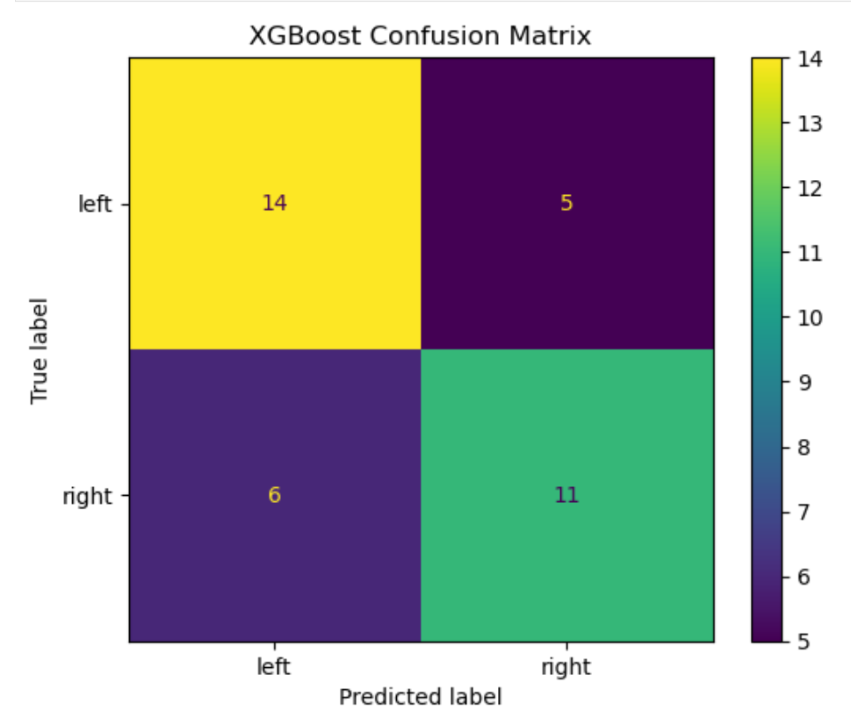
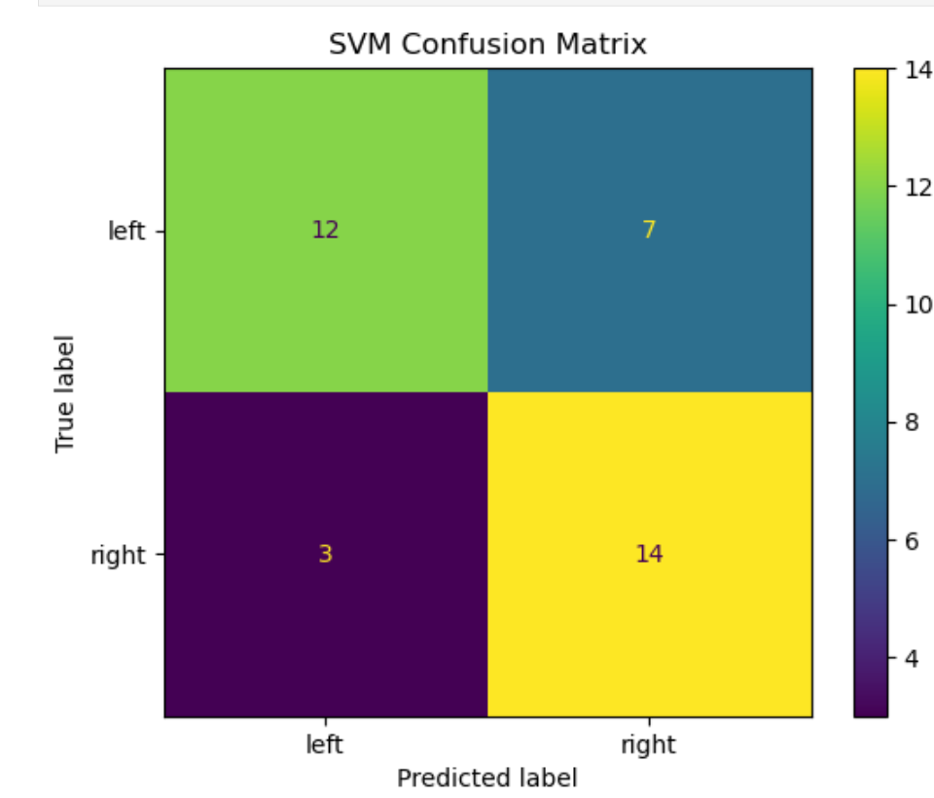

Slide 15
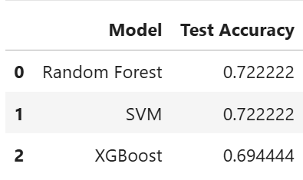
Results
Our Models achieved moderate accuracy (~70%)
Performance improved after removing biased features

Slide 16
Conclusion & Future Work
Mouse dynamics can predict hand usage, our results are promising but not perfect.
Future Work:
collect data from more users in more controlled settings
Include more left-handed participants to fix our bias issue

Slide 17
Questions?

